Slide 1
PQ-IVR Study
August 1, 2017

Slide 2
Needs Assessment
Provide voltage sag protection up to 1 MW of customer load
Provide voltage recovery both for balanced and unbalanced faults
Fault power at the site: 65 MVA on the high side (12.47 kV) of the customer transformer. X/R ratio: 5.92
The fault recordings are on the low side (277 V L-N) of the customer transformer, which is WYE-WYE connected
There is enough space to house the outdoor D-VAR and its transformer. Will need to determine if space is available for a Current Limiting Reactor installation.

Slide 3
The AMSC PQ-IVR® System: Key Components
N.O. Bypass Switch
Protected
Loads
Utility
Transmission Source
Current Limiting Reactor
D-VAR® STATCOM Units
Power Factor
Correction Caps
D-VAR STATCOM Units with step-up transformers
Power factor correction caps (harmonic filters)
Current Limiting Reactors
MV breakers and reactor disconnect switches

Slide 4
The AMSC PQ-IVR® System: Key Components
N.O. Bypass Switch
Protected
Loads
Utility
Transmission Source
Current Limiting Reactor
D-VAR® STATCOM Units
Power Factor
Correction Caps
D-VAR STATCOM Units with step-up transformers
Power factor correction caps (harmonic filters)
Current Limiting Reactors
MV breakers and reactor disconnect switches

Slide 5
The AMSC PQ-IVR® System: Key Components
N.O. Bypass Switch
Protected
Loads
Utility
Transmission Source
Current Limiting Reactor
D-VAR® STATCOM Units
Power Factor
Correction Caps
D-VAR STATCOM Units with step-up transformers
Power factor correction caps (harmonic filters)
Current Limiting Reactors
MV breakers and reactor disconnect switches

Slide 6
The AMSC PQ-IVR® System: Key Components
N.O. Bypass Switch
Protected
Loads
Utility
Transmission Source
Current Limiting Reactor
D-VAR® STATCOM Units
Power Factor
Correction Caps
D-VAR STATCOM Units with step-up transformers
Power factor correction caps (harmonic filters)
Current Limiting Reactors
MV breakers and reactor disconnect switches

Slide 7
The AMSC PQ-IVR® System: Key Components
N.O. Bypass Switch
Protected
Loads
Utility
Transmission Source
Current Limiting Reactor
D-VAR® STATCOM Units
Power Factor
Correction Caps
D-VAR STATCOM Units with step-up transformers
Power factor correction caps (harmonic filters)
Current Limiting Reactors
MV breakers and reactor disconnect switches

Slide 8
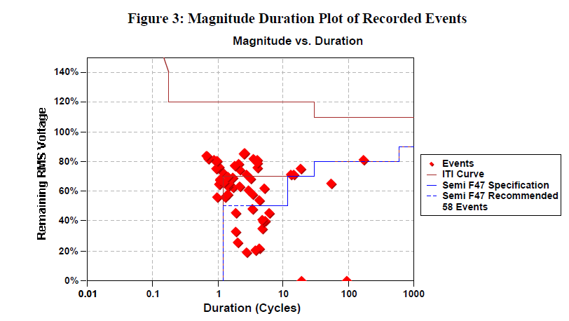
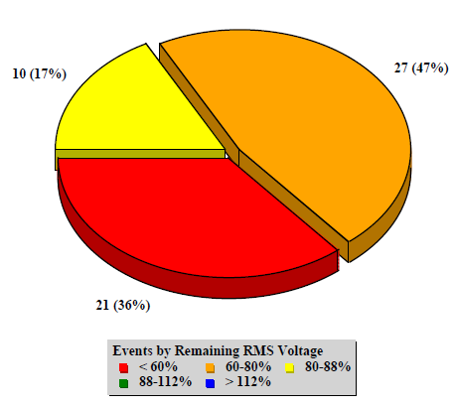
Recorded Events

Slide 9
Summary of Options
Model for the Proper Solution
2 MVAR D-VAR: 2 MVAR steady state (6 MVAR overload/transient) capability. Will need a separate D-VAR transformer. 7-9% voltage rebuild
4 MVAR D-VAR: 4 MVAR steady state (12 MVAR overload/transient) capability. Will need a separate D-VAR transformer. 15-18% voltage rebuild
8 MVAR D-VAR: 8 MVAR steady state (24 MVAR overload/transient) capability. Will need a separate D-VAR transformer. 30-35% voltage rebuild
Recommended Option – 2 MVAR D-VAR with a Current Limiting Reactor: Same as option to, but with the addition of the reactor to reduce the fault power to 10 MVA. 50-55% voltage rebuild

Slide 10
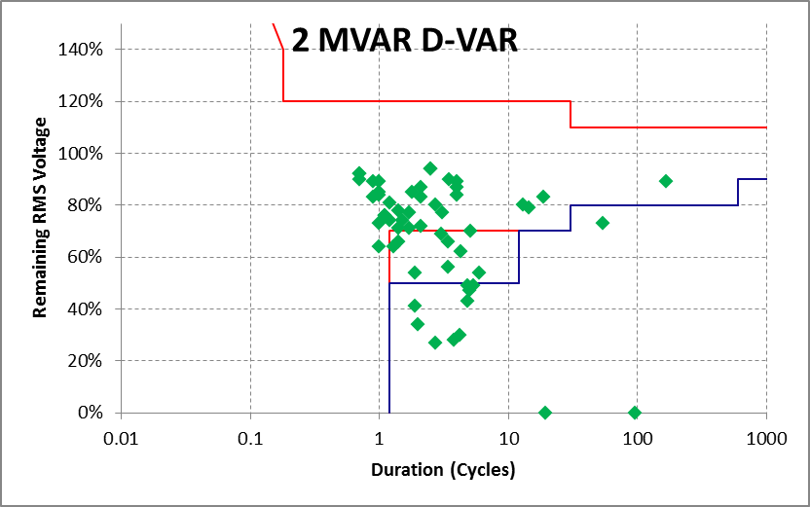
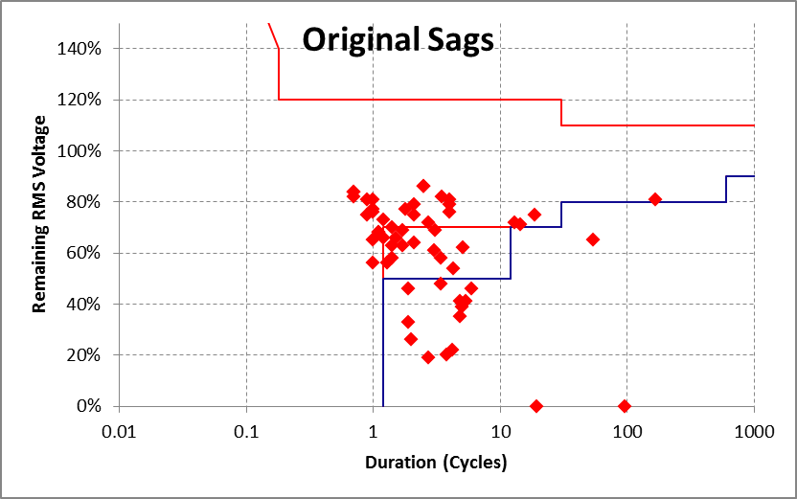
Option 1 – D-VAR (2 MVAR)
7-9% voltage rebuild

Slide 11
Option 1 – D-VAR STATCOM (2 MVAR)
7-9% voltage rebuild
Bill of Materials:
  2 MVAR D-VAR STATCOM Power Module
  2 MVA 12.47kV/480V transformer
  Master Control Enclosure (MCE)
  12.47 kV circuit breaker
Budgetary pricing
  $527,249 USD
12.47 kV
2 MVAR
PQ-IVR
Inverters
2
MVA
Up to 1 MVA customer load

Slide 12
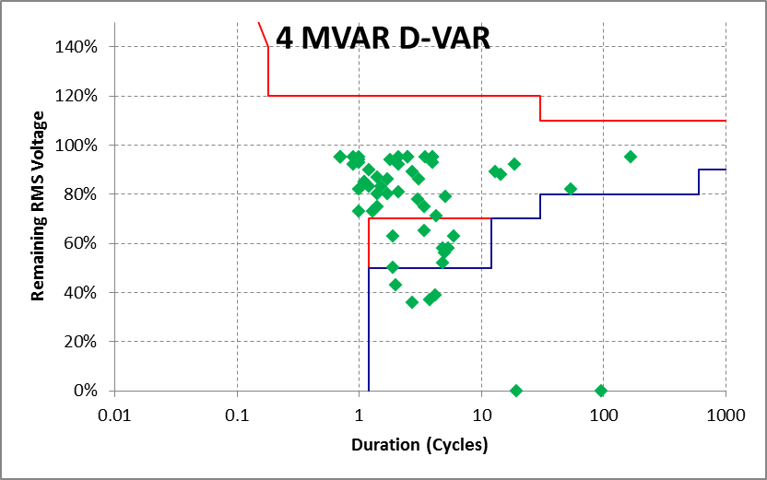
Option 2 – D-VAR (4 MVAR)
15-18% voltage rebuild

Slide 13
Option 2 – D-VAR STATCOM (4 MVAR)
15-18% voltage rebuild
Bill of Materials:
  4 MVAR D-VAR STATCOM Power Module
  4 MVA 12.47kV/480V transformer
  Master Control Enclosure (MCE)
  12.47 kV circuit breaker
Budgetary pricing
  $707,249 USD
12.47 kV
4 MVAR
PQ-IVR
Inverters
4
MVA
Up to 1 MVA customer load

Slide 14
Option 3 – D-VAR STATCOM (8 MVAR)
30-35% voltage rebuild
Bill of Materials:
  2 x 4 MVAR D-VAR STATCOM Modules
  8 MVA 12.47kV/480V transformer
  Master Control Enclosure (MCE)
  12.47 kV circuit breakers
Budgetary pricing
  $1,191,461 USD
12.47 kV
2 x 4 MVAR
PQ-IVR
Inverters
4
MVA
4
MVA
8 MVA Transformer
Up to 1 MVA customer load

Slide 15
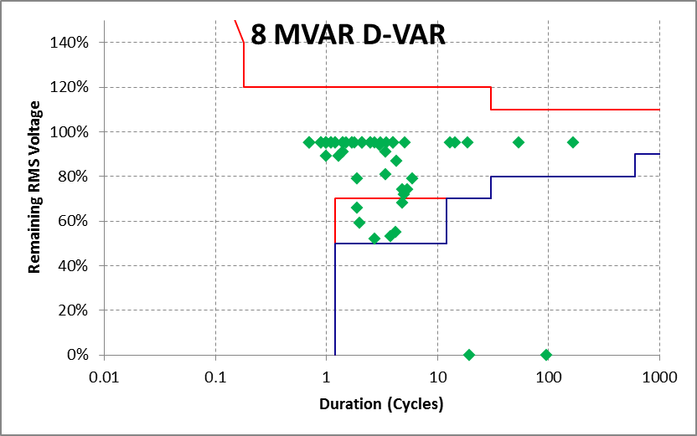
Option 3 – D-VAR STATCOM (8 MVAR)
30-35% voltage rebuild

Slide 16
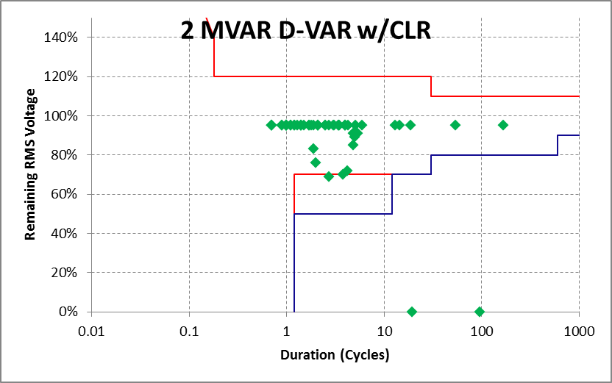
Option 4 – D-VAR (2 MVAR) w/CLR
50-55% voltage rebuild

Slide 17
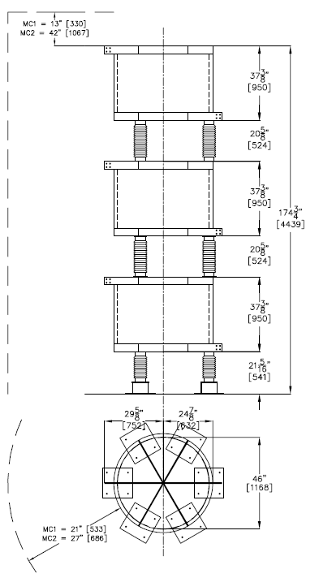
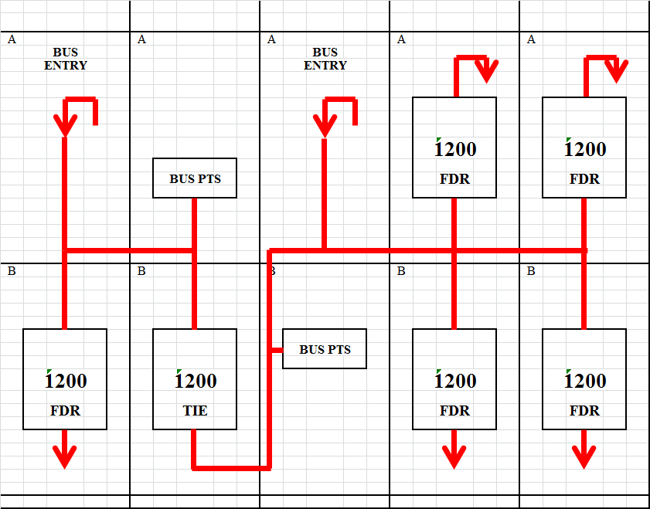
Typical Dimensions – CLR and Switchgear, and Cap bank for PQ-IVR Applications
CLR - Approximately 8’ of clearance required
Metal Enclosed Cap Bank - Approximately 12.5’L X 8’H x 6’W
Metal Enclosed Cap Bank
Approximately 12.5”L x 8’H x 6’W
Switchgear - Approximately 15’L X 9’H x 9’W

Slide 18
Option 4 – D-VAR STATCOM (2 MVAR) w/CLR
50-55% voltage rebuild
Bill of Materials:
  2 MVAR D-VAR STATCOM Module
  2 MVA 12.47kV/480V transformer
  3 phase 40 amp 12.47 kV 35 mH reactor
  Master Control Enclosure (MCE)
  2 x 200 kVAR caps
  5 position 600 amp 12.47kV Outdoor Metal Enclosed switch gear
Budgetary pricing
  $817,202 USD
12.47 kV
40 A
Current
Limiting
Reactors
34.9 mH
2 MVAR
PQ-IVR
Inverters
By-pass switch
2
MVA
2x200 kVAR
Multi-step
PF correction
Cap bank
Up to 1 MVA customer load

Slide 19
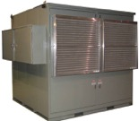
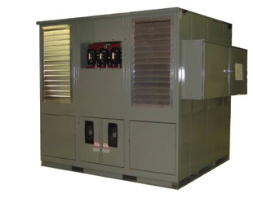
The D-VAR® STATCOM System
Provides sub-cycle dynamic reactive capability – both leading and lagging
Has short term overload capability of 3.0 times its continuous rating
Seamlessly switch other shunt devices and is in communication with the utility system operations & control center via SCADA
Fast dynamic response that is tuned based on applications specific requirement

Slide 20
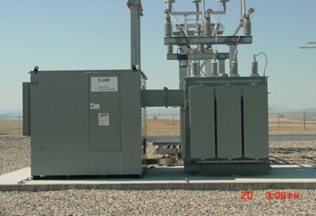
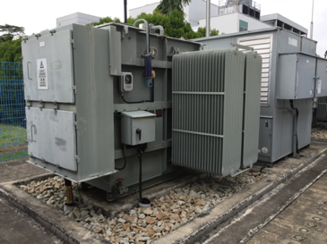
Modular STATCOM Units
Close-Coupled to Substation Class Transformer
Forced (ambient) air cooled systems
Simple Installation requirements
Can go in varied environmental conditions
1 or 2 transformer configurations

Slide 21
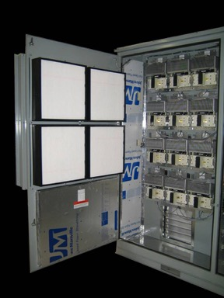
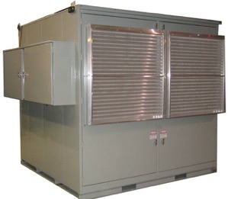
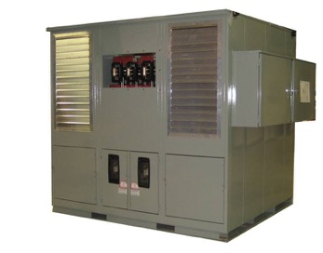

The D-VAR® STATCOM - Preventive Maintenance
Checks: Filters clean/replace, general condition, louvers, fans, exhaust passages, check heater operation
Front Louvers
Exhaust Louvers
Air Filters
Power Inverters
Easy to Maintain – 24 x 7 Monitoring by AMSC Available
Notes:
A close up look of the PME is shown here painted in typical utility grey. The D-VAR units are very vey modular. For the most part, they are all the same. Now and then some of them get a tweak here and there.

Slide 22
The D-VAR® STATCOM System - Controller
Custom panel arrangement that can be easily integrated in control building
Media converter and Internet switches
Touch Screen Computer
Push Buttons and Indicator Lights
2000 mm
Test Switches
Quick access to touch screen computer (HMI),test switches, media converters and internet connections
200 mm
800 mm
600 mm

Slide 23
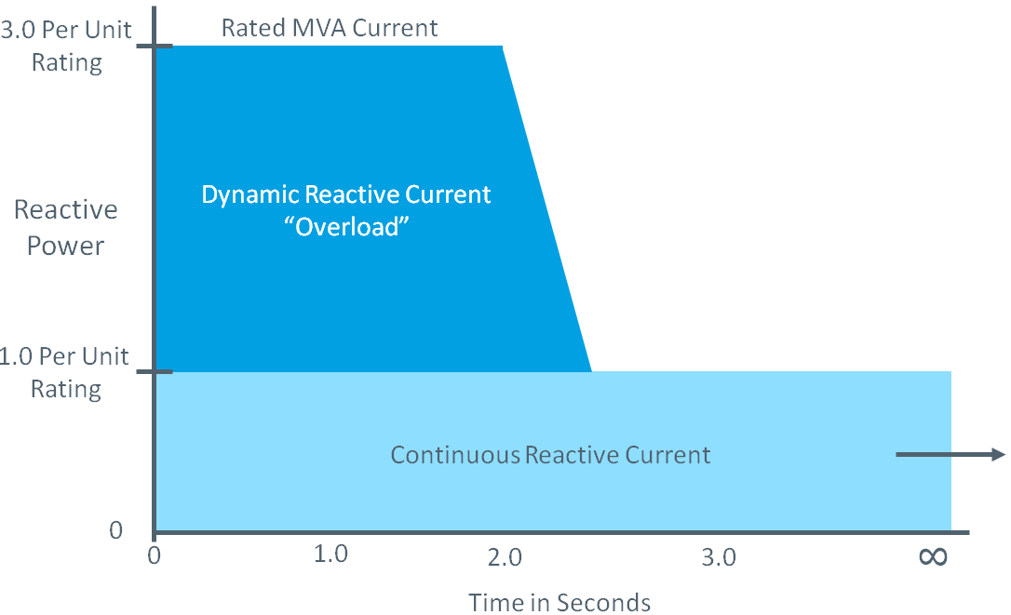
AMSC D-VAR® STATCOM Feature
- Overload Capability

Slide 24
D-VAR® STATCOM Overload
Dynamic Reactive Current
“Overload” as a Function of Duration
3.0 Per Unit
Rating
Rated MVA Current
Reactive Power
1.0 Per Unit
Rating
Continuous Reactive Current
0
8
0
1.0
2.0
3.0
Time (Seconds)

Slide 25
D-VAR® STATCOM System
Flexible Control Options
Regulation control
  Regulate voltage, power factor, or VAR over a longer time period
  Uses D-VAR STATCOM and caps/reactors (“Soft Switching”)
  Integrates other devices such as PPC for additional VAR control
Sag Mitigation
  Fast response with short-term capability to protect local assets (load or generation)
Customer specific modes
  Motor-start mitigation
  Line drop compensation
  Power oscillation damping
Notes:
The D-VAR system has different operating modes:
Slow Regulation with Shunt Device switching. Voltage control can use line drop compensation.
Fast Transient mitigator (subcycle response)
Voltage collapse protection
Customer specific modifications
Capacitor/Reactor Bank Switching Control
Wind Farm/Solar Plant MVAR Output Control
Power Oscillation Dampening

Slide 26
D-VAR® System - Voltage Control
Regulation Control and Fast Sag Mitigation
Voltage (pu)
1.05
Hard Limit = 1.050pu
Fast Buck Turn On
1.04
1.03
Setting Options
Independent boost and buck droop
Adjustable droop: 1% to 10%
Adjustable reference or V_{Target}
Seamless transition between control modes
Voltage_{Ref}
1.02
Buck Droop = 2%
Buck Turn On
1.01
1.00
Deadband
0.99
Boost Turn On
Boost Droop = 2%
0.98
0.97
0.96
Fast Boost Turn On
Hard Limit = 0.950pu
0.95
3x
2x
1x
Current Output
1x
2x
3x
Boosting
Bucking
Notes:
Voltage control set of parameters that define droop curves, and our system response. Shows generic curve and how parameters are related. Droop stable operation.
Explain axes.
Blue
Vref. DB. On.
Red
In regulation mode set of params to customize V level to Reg to, other params such as droop and turn on levels.
Diagram shows generic droop profile and highlights how these parameters are related.
Normal conditions operating in regulation control. Y axis is voltage, X axis is D-VAR output in VARs. Left is capacitive & right is inductive.
In regulation have a specified target voltage, hold reg bus to this voltage.
Deadband, this prevents D-VAR from switching on and off around voltage reference. Defined by turn on points
~~~~~~~~~~~~~~~~~~~~~~~~~~~~~~~
In Slow regulation mode (voltage regulation control mode) the D-VAR system has a set of parameters that can be set to customize the voltage level to regulate to, and other parameters such as the deadband and droop and turn on levels.
Here we’re showing a generic slow control droop profile, which shows how the parameters are related.
Under normal conditions, the D-VAR will operate according to the slow control parameters (in blue). The x-axis is showing the D-VAR output in VARs (on the left are capacitive VARs, to boost, and on the right are inductive VARs to buck), and on the Y-axis we’re showing the voltage.
The D-VAR has a voltage target (Vref, [point out target voltage on diagram]), and the D-VAR will adjust it’s output to try to hold the regulated bus to this target voltage. Now, to avoid having the D-VAR switching on and off frequently due to very small variations around this target voltage, we often will have a deadband around the target voltage, which is defined by the Slow Boost Target Delta and Slow Buck Target Delta. So, as long as the regulated bus voltage is sitting at the target voltage setpoint, or within this deadband of the target voltage, then the D-VAR will not do anything. Once the regulated bus voltage falls outside of the range indicated by the dotted blue lines, then the D-VAR turns on and starts to put out VARs. These turn on levels are defined by the parameters Slow Boost On Delta and Slow Buck On Delta.
Now, the D-VAR operates with a droop characteristic for more stable control. Without the droop, the D-VAR would respond to slight variations of voltage by putting out its full capability (capacitive or inductive). So these lines dictate how many VARs the DVAR will put out. According to these curves on this diagram, which show a 2% boost and buck droop, the D-VAR will be at it’s full bucking capacity (4 MVAR inductive) when the regulated voltage is at 1.025pu or higher. The D-VAR will be at it’s full boosting capacity (4 MVAR capacitive) when the regulated voltage drops to 0.975pu or lower. If the regulated bus is at 0.99pu, then the D-VAR will put out a reduced amount of capacitive VARs (about 1MVAR in this case). So you can see the droop allows for smooth operation of the D-VAR, and you don’t end up in a situation where the D-VAR is going from being at it’s full capacitive output to it’s full inductive output for any change in voltage. A larger droop (which would mean a steeper slope here [point to slow buck droop]) would allow for more a more stable system, but the range for rebuild would be much larger.
All of these parameters (everything below Vref) are defined relative to the target voltage. So if the target voltage was adjusted to a different voltage, say from 1.00pu to 1.02pu, then these curves would just shift accordingly just by only changing the reference voltage parameter and nothing else.
~~~~~~~~~~~~~~~~
The D-VAR control system is typically in voltage control mode where the system is customized to control the voltage at a certain bus.
The software has a set of user settable parameters (including independent boost and buck droop slopes adjustable between 1%-10%, an adjustable reference or target voltage, deadband and output limits of the D-VAR, voltage or power factor control modes.
The droop allows for more stable operation of the system. Without a deadband or droop, the system would be turning off and on continuously or slamming to it’s full capacitive or full inductive outputs for little changes in voltage. Depending on how you set these parameters you can get very stable operation over a wide voltage range

Slide 27
Detailed Simulation Models
Generic Models
  PSS®E (CSTATT and SVSMO3U1 @ Rev 32.0.5)
  PSLF (SMES1)
  DIgSILENT PowerFactory
Detailed Equipment - Specific Models
  User Models for PSS®E (CDVAR4)
  DIgSILENT PowerFactory
  PSCAD (EMTDC)
  RSCAD (RTDS)
Detailed STATCOM model with parameters
Notes:
The models for simulating the D-VAR STATCOM are now readily available for most of the common grid analysis packages.
Siemens Power Technologies Incorporated PSS/e program is by far the most common load flow and dynamic tool used by utilities around the world today.
We have now also seen DigSilent as another popular choice.
AMSC has detailed user models developed for all of these programs, which utilizes the control code of the actual device. This allows us to undertake complex simulations of the application of these systems and may also include the switching of shunt reactive banks.
Real time Digital Simulation (RTDS) is a “hardware in the loop” simulation that allows us to simulate real-time events on the actual D-VAR control hardware. Very useful in further benchmarking our models.

Slide 28
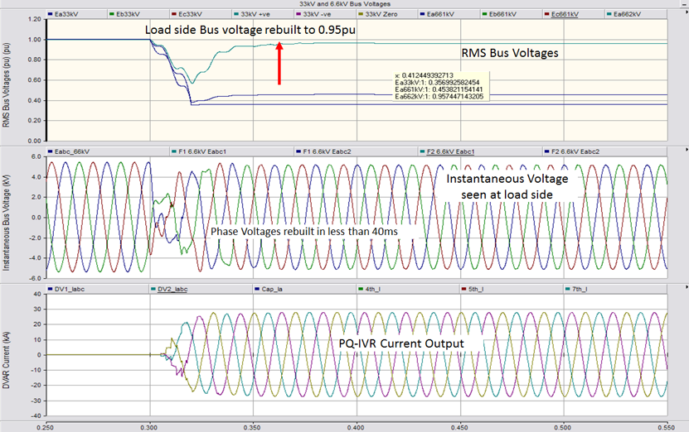
Example of System Analysis
PSCAD / 3-Phase Fault / with PQ-IVR® Solution In-Service

Slide 29
PQ-IVR -Independent Phase Operation

Slide 30
Questions?
Bob McFetridge
919-901-9940
Bob.mcfetridge@amsc.com
Bilgehan.Donmez@amsc.com
(978)-842-3215
www.amsc.com

